Slide 1

DEADLOCK DETECTION AND
AVOIDANCE SIMULATOR USING PYTHON
Concepts, Algorithms, Workflow, and Performance
Presenter
shalini sharma
submitted to
Priyank Dubey sir

Slide 2











DEADLOCK CONCEPTS
AND KEY ALGORITHMS
P1
Deadlock occurs when processes wait indefinitely for resources held by others
Need matrix helps decide what a process still requires Need = Maximum - Allocation
P3
A cycle in the wait relationships can lead to deadlock
R2
Banker's Algorithm checks if the system is in a safe state and finds a safe sequence
Sample safe sequence: P1 → P3 → P4 → P0 → P2
R1
P2
Deadlock Detection Algorithm identifies processes that cannot finish

Slide 3














SIMULATOR WORKFLOW
FLOWCHART
01
02
03
04
05
06
07
USER INPUT
MATRIX
CREATION
NEED
CALCULATION
BANKER’S
ALGORITHM
DEADLOCK
DETECTION
RESOURCE
REQUEST
CHECK
FINAL
RESULT
Allocation,
Maximum,
Available,
Request
matrices
Build system
state from
input matrices
Compute
Need =
Maximum –
Allocation
Check safe
state and
determine
safe sequence
Identify
unfinished
processes
Output safe
sequence
or deadlock
report
Evaluate
requests and
grant or deny

Slide 4






KEY IMPLEMENTATION
FUNCTIONS AND LOGIC
def calculate need(Max, Allocation) :
Need = matrix(rows, cols)
for i in rows:
for j in cols: Need[i][j] = Max[i][j] – Allocation[i][j]
return Need
calculate need()
Computes the Need matrix from Max and Allocation.
def bankers Algorithm(Available, Max, Allocation, Need) :
while unfinished processes exist:
if Need[i] <≤ Available:
Available ±= Allocation[i]; mark i finished
return safe sequence if all finished else failure
bankers Algorithm()
Checks system safety and returns a safe sequence.
detect_deadlock()
def detect deadlock(Available, Max, Allocation, Need) :
if bankers Algorithm(...…) == failure:
return List of unfinished processes
else: return none
Identifies unfinished processes when no safe state exists.
resource request()
def resource request(process, Request, Available, Max, Allocation, Need) :
if Request <≤ Need process) and Request <≤ Available:
pretend to allocate and run bankers Algorithm(...…)
grant if safe else rollback and deny
else: deny request
Evaluates additional requests and grants only if safe.
Clear decision points
Each function uses defined checks to ensure system safety.

Slide 5
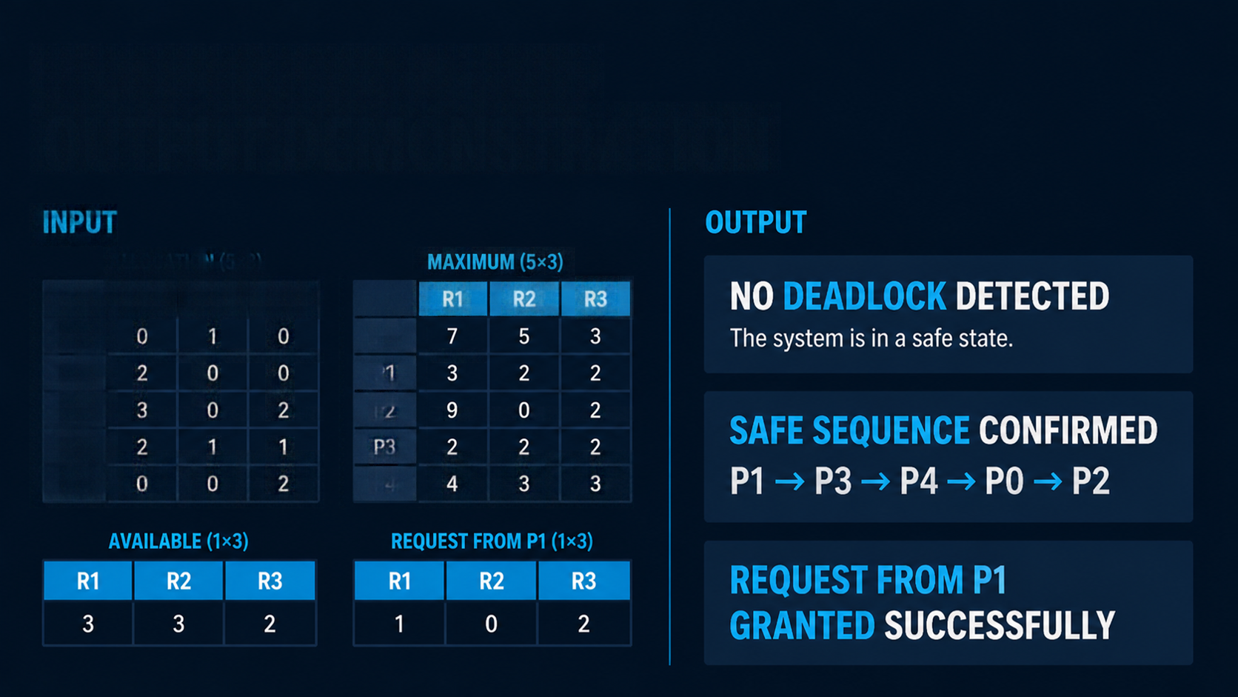




















SAMPLE INPUT AND
OUTPUT DEMONSTRATION
INPUT
ALLOCATION (5×3)
MAXIMUM (5×3)
R1
R2
R3
R1
R2
R3
P0
0
1
0
P0
P1
2
0
0
P1
P2
3
0
2
P2
P3
2
1
1
P3
P4
0
0
2
P4

Slide 6





PERFORMANCE ANALYSIS
AND COMPLEXITY
def is_safe(available, max, allocation, need):
n = 1en(allocation)
# = 1en(available)
work = available.copy()
finish = [False] * n
safeSequence = []
while 1en(safeSequence) < n:
found = False
for i in range(n):
if not finish[i] and all(need[i][i] <s work[1])
for j in range(m):
work = [work[i] + allocation[i][i]
for j in range(m):
finish[i] = True
safeSequence.append([i])
found = True
return 1en(safeSequence) == n, safeSequence
Matrix calculation
O(n × m)
Scales with processes and resource types
Banker’s Algorithm, Deadlock Detection, Resource Request
O(n² × m)
Each involves nested checks
What it means
Complexity grows with more processes and more resource types

Slide 7


CONCLUSION AND
EDUCATIONAL TAKEAWAYS
The simulator detects deadlocks and grants requests safely.
Banker's Algorithm finds safe sequences
and prevents deadlocks.
Deadlock Detection Algorithm identifies processes involved in deadlock.
Performance is suitable for learning with moderate-sized inputs.
Explore further improvements and
real-world applications.
Understanding and simulating deadlock avoidance
is key to safe resource management in operating systems.

